Slide 1
Portfolio Performance Evaluation
(Group 5: Ceyda Çelikdoğan, Enes Tayyip Burca, Osman Valimammadli, Shukhrat
Khuseynov)

Slide 2
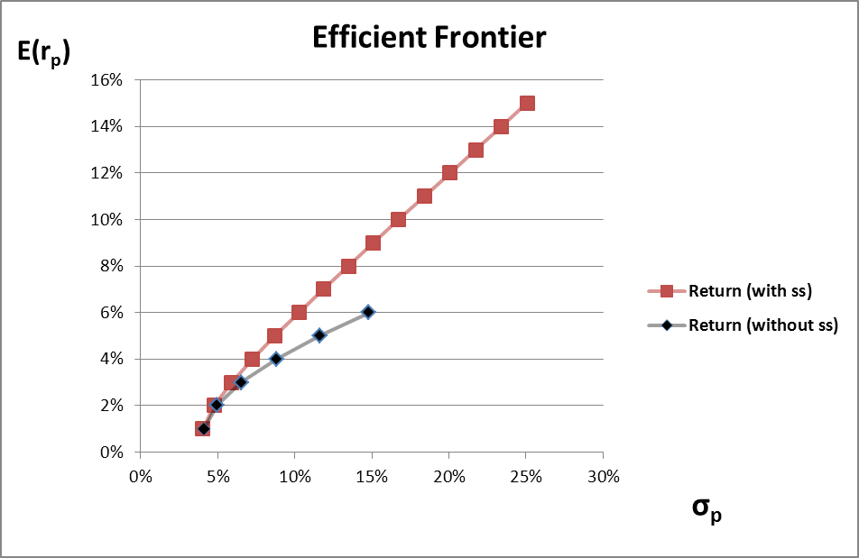
Initial forecast and allocation
Given the standard deviation of 6.5%, 4 stocks were chosen through optimization:

Slide 3
Initial forecast and allocation
The allocation of money and shares in the chosen portfolio were as follows:

Slide 4
Holding period
This portfolio composition was virtually bought on Bloomberg (TMSG) as the market opened on Thursday, April 18th, 2019 and was sold back after four weeks, when the market opened on Thursday, May 16th, 2019:

Slide 5
Weekly returns
Using the observed data, the weekly returns and some relevant statistics were calculated:

Slide 6
Risk adjusted performance measures
Utilizing the weekly returns, risk adjusted performance measures and the holding period returns were calculated in order to evaluate and compare the performance of the portfolio:

Slide 7
Conclusion
If to compare the portfolio measures with the market, all of them, holding period return, excess returns and volatility measures, appear to be greater, i. e. superior to the market.
On the other hand, while comparing with the portfolio of Group 6 (Friends’ portfolio), it can be observed that our portfolio is superior according to holding period return and all risk adjusted performance measures, except for the Sharpe ratio and M² measure, which are slightly greater in the friends’ portfolio. It means that the risk is more rewarded (or has less loss per each unit of risk in this case) in the friends’ portfolio.

Slide 8
Conclusion
Therefore, despite the fact that the portfolio has absolute loss due to considerable decline in the Turkish market, it is not doing as bad as the market on average and possibly a random (friends’) portfolio.

Slide 9
The End

